Slide 1
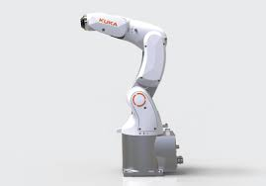
Robust collision detection and isolation

Slide 2
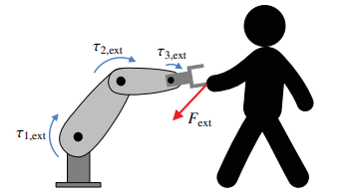
Task
estimation of external torque in a 3R spatial robot manipulator
Compare two methods: Momentum Observer Residual and Sliding Mode Observer with Multiple Layers (SOSML)
Isolate and react to the external Force applied
Notes:
1crucial for safe and efficient operation in industrial and automation settings
Accurate external torque estimation in robotics is challenging due to uncertainties, disturbances, and modeling errors
2to assess their performance in diverse scenarios.

Slide 3

Robot Dynamics

Slide 4

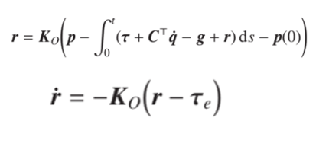

Momentum Observers
First-Order Momentum Observer
If K0 large
Noise:
Notes:
5First-order filtered so compromise between noise attenuation and estimation performance

Slide 5

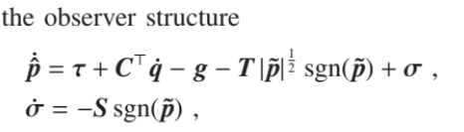

Sliding mode momentum observers
STA

Slide 6




SOSM momentum observer
Firstly choose S and then the parameter T
T is a proportional gain and S an integral gain
Notes:
Here the difference is that the states are directly a measure of p and torque
S is the absolute value of the slope of σ (see (7)), it determines the tracking capability.
If the slope of the external torque is higher than σ, then the observer is not capable of tracking the reference signal
The parameter T can now be interpreted as the equivalent of a proportional gain, while the parameter S is the equivalent
of the integral gain.
Too high values for T will lead to an overshoot, while too small values result in poor convergence.

Slide 7

SOSML Momentum Observers
The parameters S2, T2 of the SOSML momentum observer are selected such that the equivalent second-order linear system has the same cutting frequency as the first-order momentum observer.
Notes:
The advantage of the SOSML over the SOSM is in the behavior of the system far from the equilibrium point in the origin
While the effect of the nonlinear terms is stronger than the linear ones near the equilibrium point (resulting in a finite time rather than exponential convergence), the linear terms are predominant the farther the initial condition is from the origin.
For the SOSML momentum observer, the linear terms correspond to those of a as second-order linear filter. Thus, T2 and S2 can be chosen, for example, such that critical damping is achieved.

Slide 8
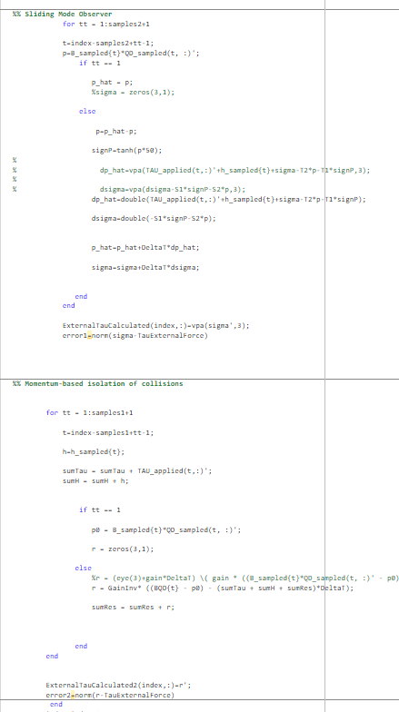
Code implementation
Challenges in torque estimation, acceleration computation, and gain optimization.
Two approaches, Momentum Observer and SOSM, were employed to estimate external torque.
Gain optimization for both approaches involved extensive testing to find the best compromise between convergence speed, disturbance rejection, and stability.
Comprehnsive simulations were conducted to evaluate the control system's performance under different conditions, including scenarios with and without noise
Notes:
The code first maintains a zero velocity state for stability before active control begins.
4considering many possible combinations of parameters

Slide 9
Simulation and Results
Comparative analysis between simulations with and without velocity measurement noise.
The analysis focused on quantifying the impact of noise on:
Torque estimation accuracy
Trajectory tracking precision
Step response performance.
The control system remained robust and capable of achieving satisfactory performance in many tests, even under noisy conditions.
All the following graphs are executed with the best weights calculated
Sometimes, with strange control laws for the robot, the SOSM doesn’t work perfectly

Slide 10
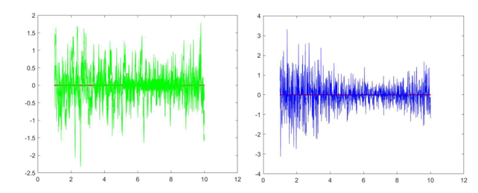
First test – only noise
-Static external torque to the robot manipulator at a specific joint.
SOSM control system accurately estimated the static external torque and effectively compensated for it. Moreover, the control system demonstrated robustness to the velocity noise, exhibiting minimal impact on torque estimation accuracy.
-change in the Momentum Observer's gain led to a deterioration in performance when noise was present.

Slide 11
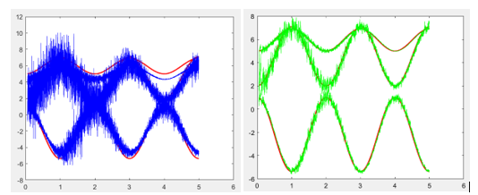
Second test – Following trajectory
- Evaluated the ability of the SOSM control system to follow a predefined trajectory.
- The SOSM exhibits superior performance
Notes:
The robot manipulator was commanded to trace a complex trajectory, and the control system's performance was analyzed.
the SOSM's performance is better, highlighting its robustness in dealing with changing external conditions.

Slide 12
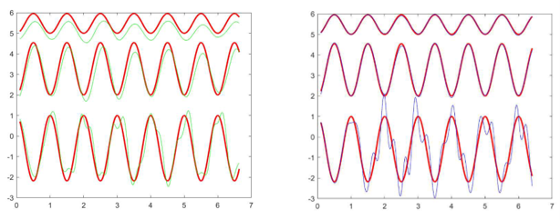

Slide 13
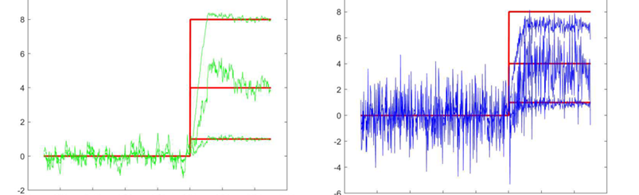
Third test – Step Respons
Step response analysis to evaluate the SOSM control system's transient behavior and stability.
The SOSM outperforms other methods in reducing noise and achieving a faster response.
Notes:
A step input was applied to the control system, and its response was observed.
The SOSM control system exhibited a fast and stable response to changes in the input, with excellent settling time and minimal overshoot.

Slide 14
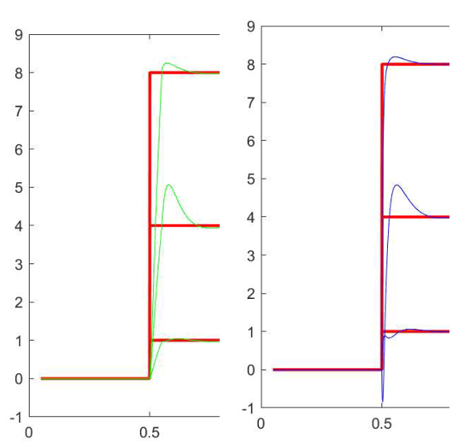
Step response analysis without noise.
Similar responses

Slide 15

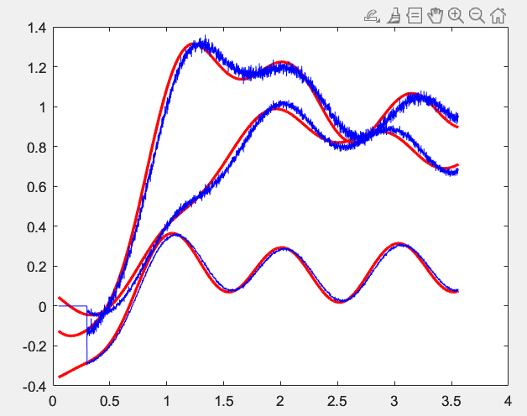
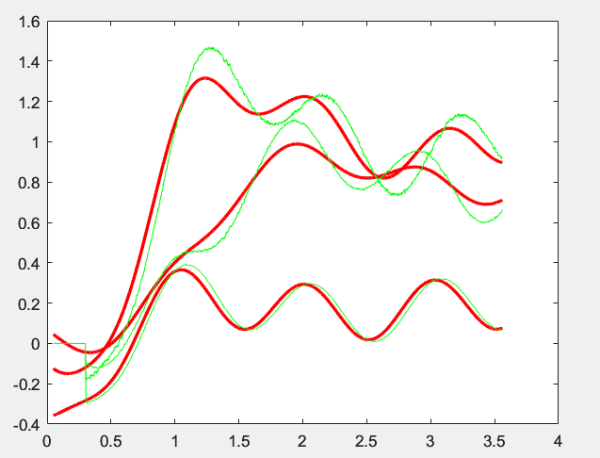
Force application

Slide 16
SOSML vs First Order Momentum observer
1)The estimation noise for the state-of-the-art technique is proportional to KO and the inertia of the system. On the contrary, the noise level in the SOSML momentum observer depends only on the selected gains (S
2) the dynamic response of the first-order momentum observer is mainly affected by its gain and not by a
noisy velocity. For the SOSML momentum observer, both have an influence,
3)the amplitude of the estimation noise is proportional to the velocity noise power for the classic momentum observer, but not for the SOSML one.

Slide 17

Safe reaction to collisions

Slide 18
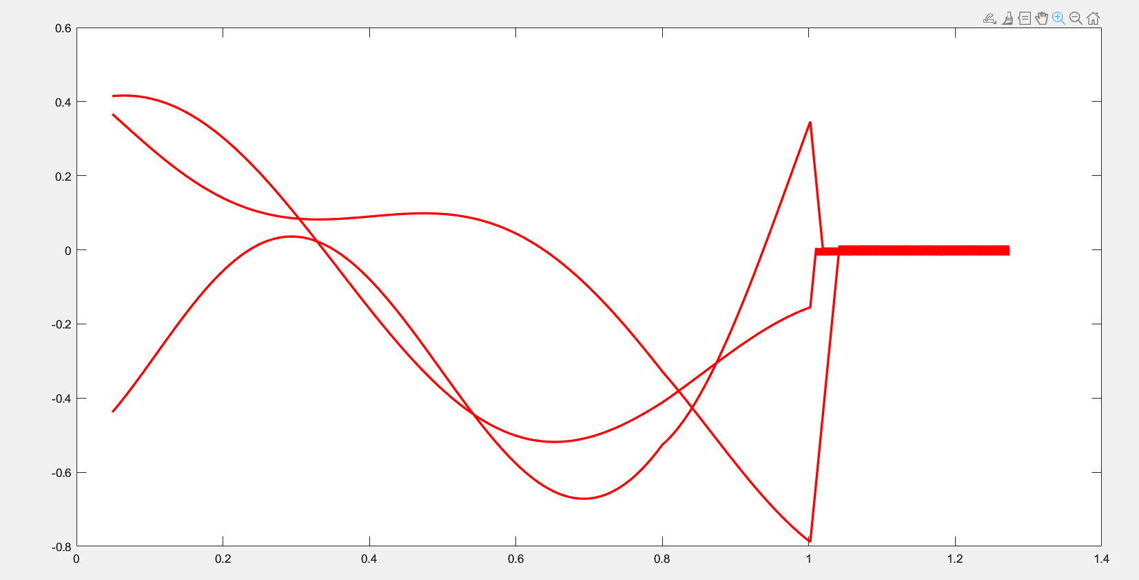
Reaction after a collision of a Force [1,2,3]. CONTROLLED STOP
deceleration strategy. 20 [m/s2]
Gradually reducing its speed
Notes:
To mitigate the impact of the encountered force and ensure the safety of the robot and its surroundings, we employ a deceleration strategy. Specifically, we apply a deceleration of 20 [m/s2] to bring the robot to a controlled stop
The primary objective of this deceleration is to prevent abrupt and potentially harmful movements of the robot. By gradually reducing its speed, we aim to avoid damage to the system and protect any individuals or objects in its vicinity

Slide 19
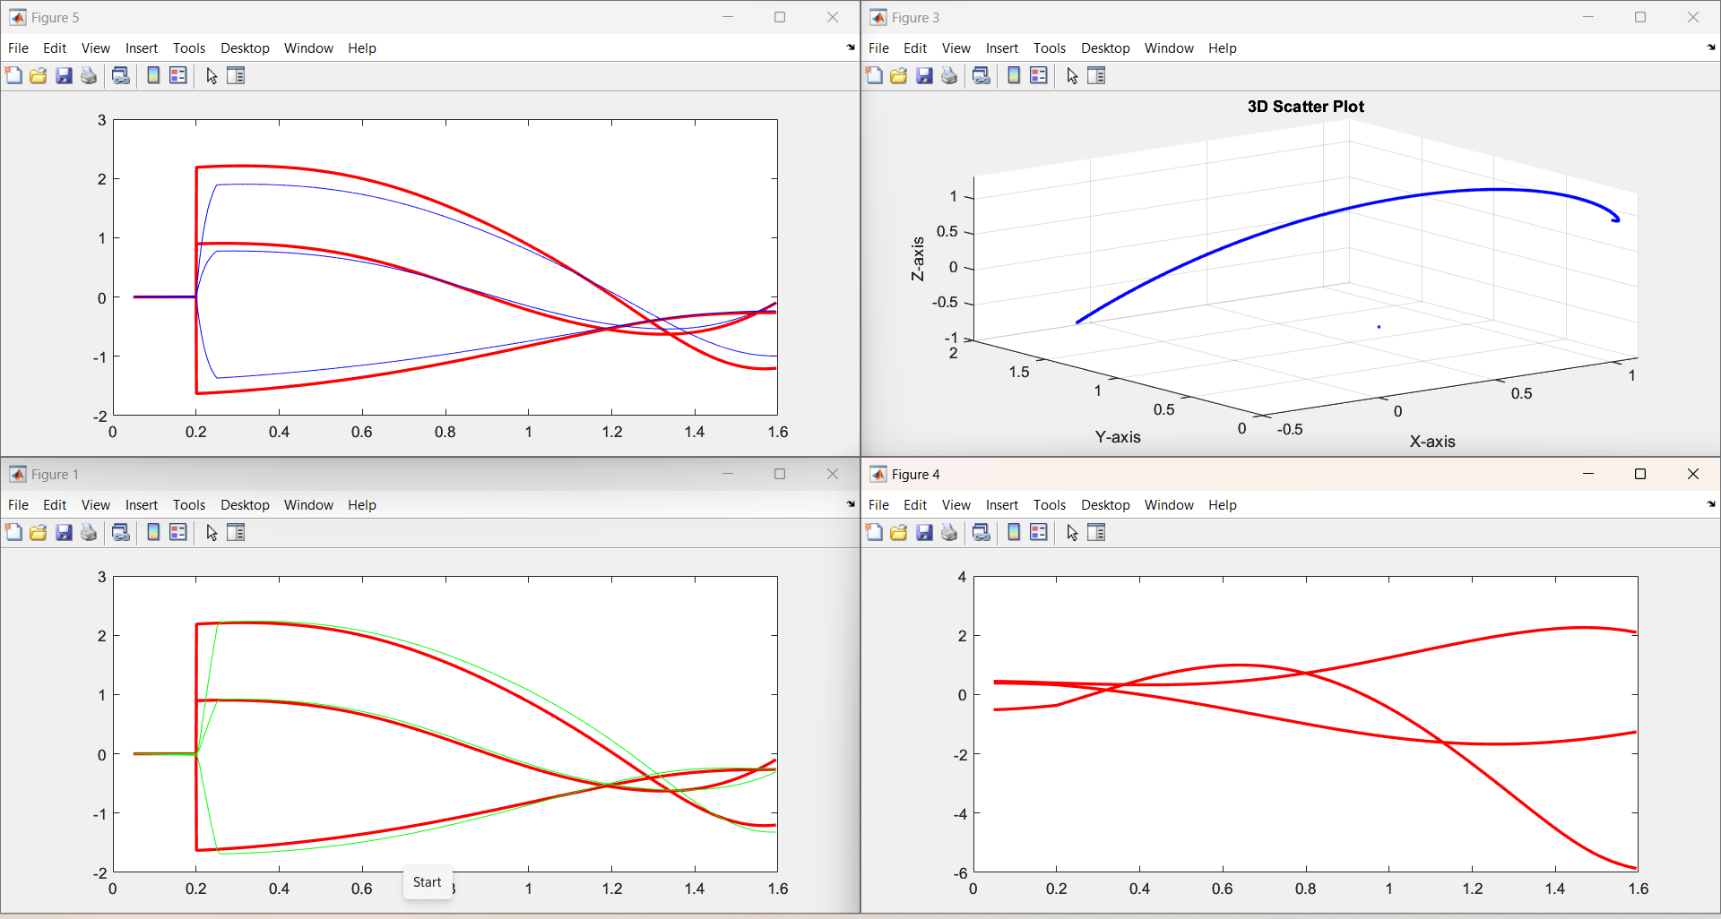

Slide 20
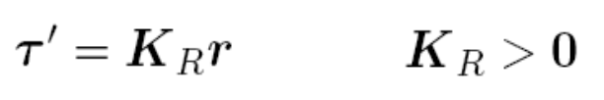
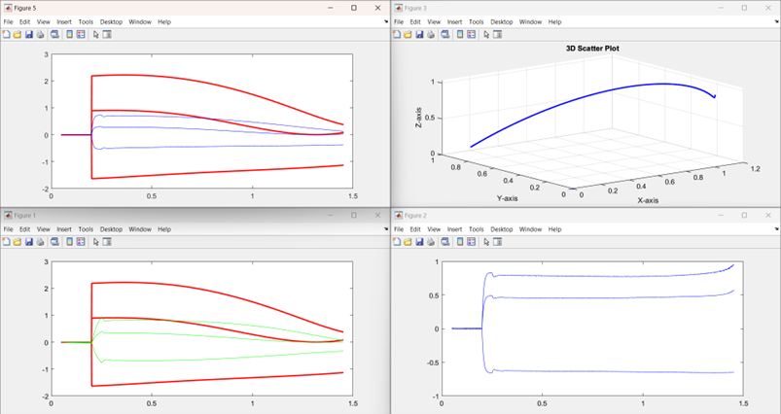
Reflex strategy
deceleration strategy. 20 [m/s2]
Gradually reducing its speed

Slide 21

Conclusion and Future Development
SOSM-based control system exhibited better performance in estimating external torques and controlling the 3R spatial robot manipulator.
The gains selection process proved successful in balancing accurate torque estimation and noise rejection.
Robustness to velocity measurement noise, ensuring stable and precise control under realistic operating conditions.
The positive outcomes from the simulations provide a solid foundation for further experimental validation and deployment of the SOSM control system in practical robotic applications.
Notes:
The simulation results clearly demonstrate that the SOSM-based control system exhibited superior performance in estimating external torques and controlling the 3R spatial robot manipulator. The gains selection process proved successful in balancing accurate torque estimation and noise rejection.
Robustness to velocity measurement noise, ensuring stable and precise control under realistic operating conditions.
The positive outcomes from the simulations provide a solid foundation for further experimental validation and deployment of the SOSM control system in practical robotic applications.

